Slide 1
HW 6 Multi-instance Object Detection and Localization
Sai Mudumba
Couple of things to note: my YOLO-like implementation has bad IoU loss in testing due to poor predicted bounding boxes

Slide 2
HW06_COCO_Downloader.py
Use the following command to download “Airplane”, “Truck”, “Person” classes from the COCO Dataset into Train and Val folders:
Train:
python hw06_coco_downloader.py --root_path C:/Users/”Sai Mudumba”/Documents/PS06/COCO/Train/ --coco_json_path C:/Users/”Sai Mudumba”/Documents/PS05/COCO2017/annotations/instances_train2017.json --class_list “airplane” “truck” “person” --images_per_class 350
Val:
python hw06_coco_downloader.py --root_path C:/Users/”Sai Mudumba”/Documents/PS06/COCO/Val/ --coco_json_path C:/Users/”Sai Mudumba”/Documents/PS05/COCO2017/annotations/instances_train2017.json --class_list “airplane” “truck” “person” --images_per_class 100
Note:
path coco_json_path might be different on your machine
code takes the first three large bounding boxes as the ground truth as three object instances, and they may be of the same class or different classes

Slide 3
HW06_Training.py
Much of the code for this script came from here: https://engineering.purdue.edu/kak/distRPG/RegionProposalGenerator-2.0.1.html
Neural Network architecture uses Skip Blocks, with 2 convolutional layers and 3 layers of batch normalization, and 3 fully connected layers
The total number of learnable parameters are 53520288
The total number of layers in the model are 158
Setting up the YOLO-like code:
The image is 128x128 pixels units and with a yolo interval of 20 pixels, the image is divided into 6x6 cells, with each of them having 5 anchor boxes (e.g., AR = 1:1, 1:3, 3:1, 1:5, 5:1), and each anchor box is represented in an 8-element vector which has the following elements: [“is the object in this cell?”, bx, by, width, height, class#1, class#2, class#3]. The last 3 elements are one-hot vector format for the classes (e.g., [1, 0, 0] or [0, 1, 0] or [0, 0, 1]). bx and by are top left coordinates of the bounding box.

Slide 4
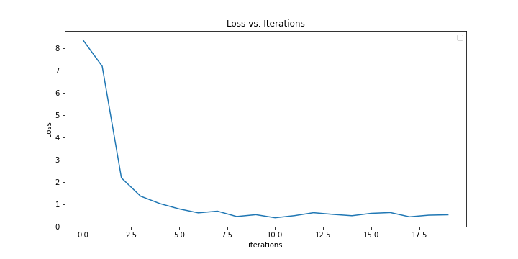
MSE Loss Training
MSE Loss function for training, for 20 epochs with batch size of 4, and recorded every 50 steps (87 iterations per epoch = 1740 iterations for 20 epochs):

Slide 5
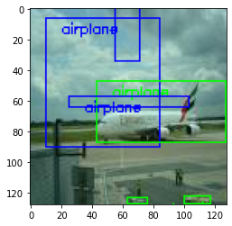
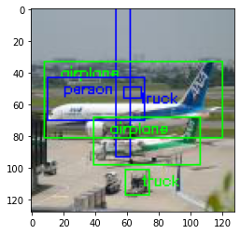


Training Images with Bounding Boxes Shown
Green is the ground truth bounding box
Blue is the predicted bounding box

Slide 6
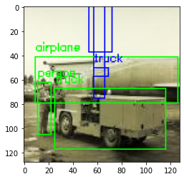
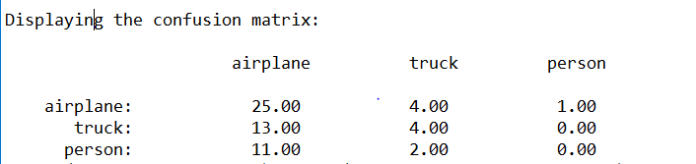
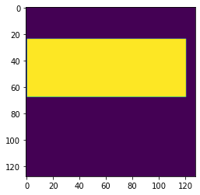
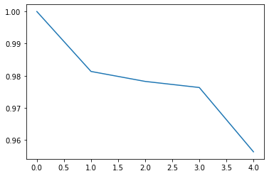
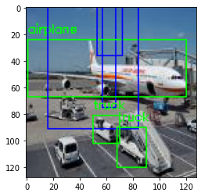
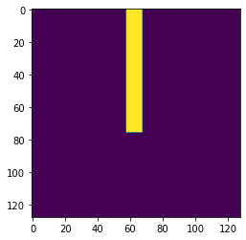
Training Accuracy and IoU Loss
Prediction
GT
Overall accuracy = 29/61
Airplane accuracy = 25/61
Truck accuracy = 4/61
Person accuracy = 0/61
A lot of these appear to be false positives since IoU loss is close to 1, meaning bad.
IoU loss
func

